Slide 1
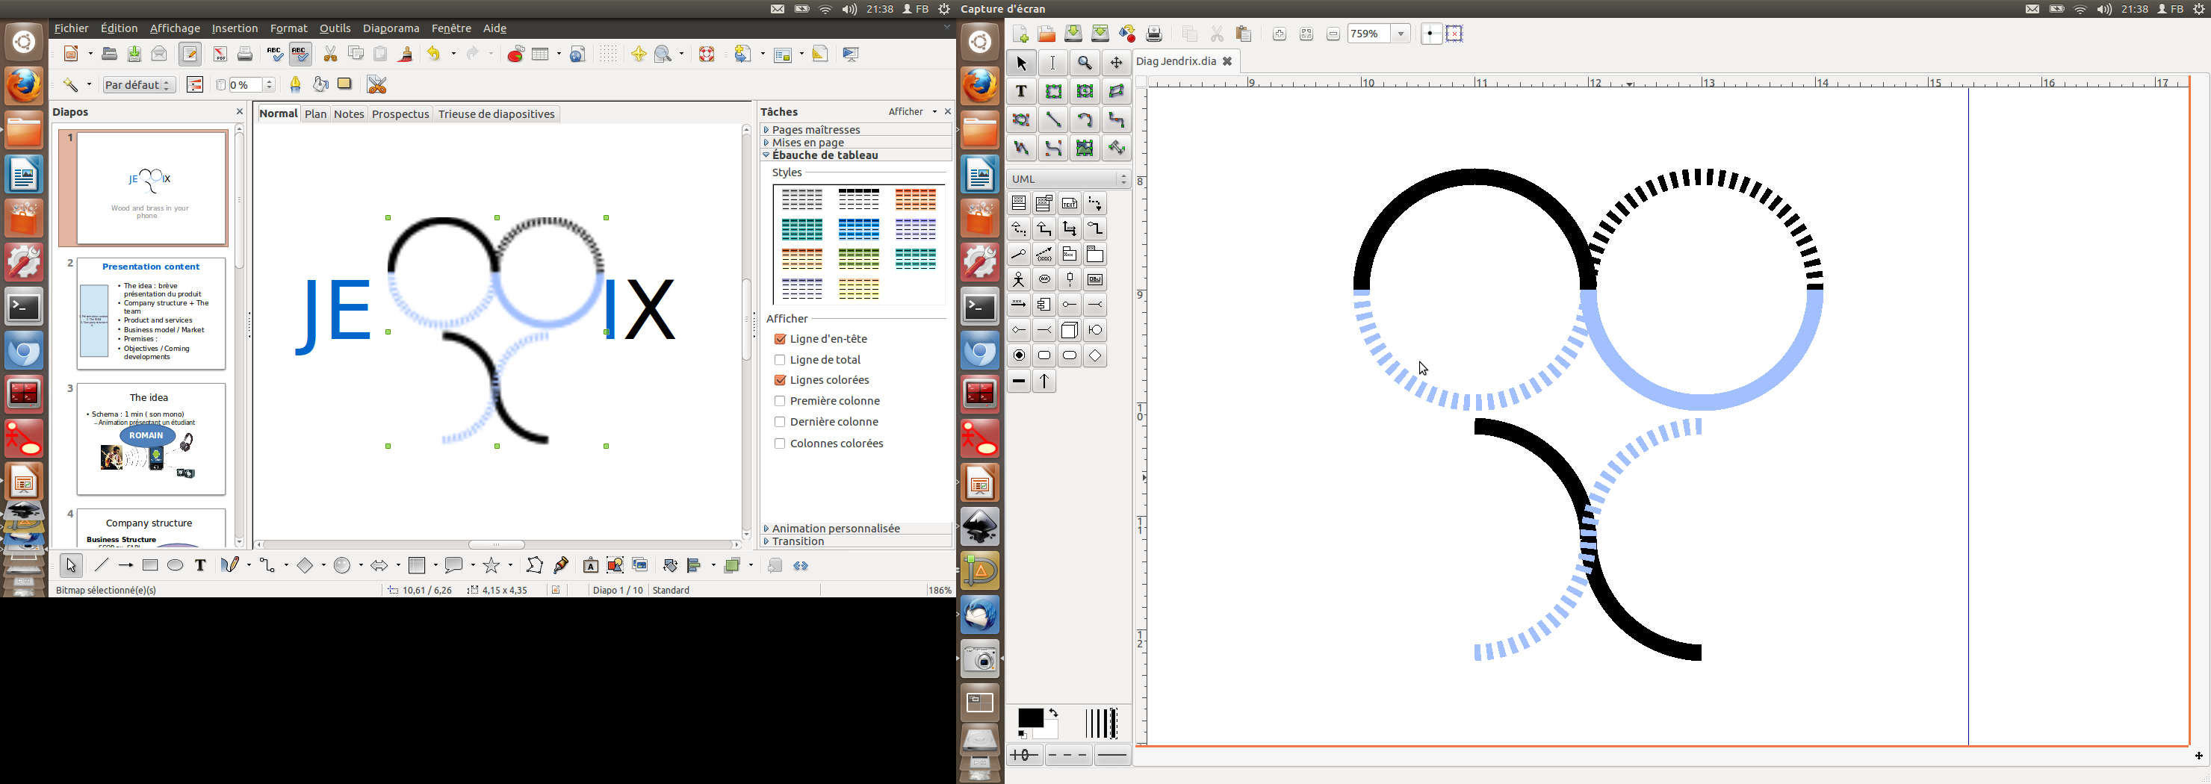
JENDRI
Wood and brass in your phone

Slide 2
Presentation content
1. The idea : Brief presentation of the product
2. Company structure and The team
3. Product and services
4. Business model / Market
5. Premises :
6. Objectives / Coming developments

Slide 3
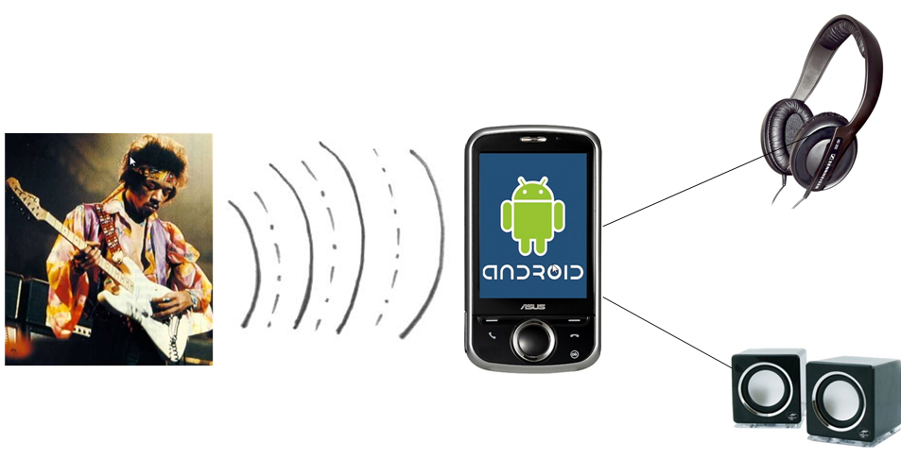
The Idea
The idea
Company structure
Product and services
Business Model / Market
Premises
Objectives / Coming dev.
Schema : 1 min ( son mono)
  Animation présentant un étudiant
ROMAIN

Slide 4
Company Structure
The idea
Company structure
Product and services
Business Model / Market
Premises
Objectives / Coming dev.
Business Structure
  SCOP ou SARL
  Actifs /passifs?
Organigramme gestion entreprise
  Holding? Partage des actions, Part des banques
Romain : Resp développement soft
Eric : Resp hardware
Florian : Resp projet / Commercial
ERIC

Slide 5
Functional organization
ERIC
Romain : Resp développement soft
Eric : Resp hardware
Florian : Resp projet / Commercial
Prévisionnel de recrutement? Branches vides
JENDRIX
Wood and brass in your phone

Slide 6
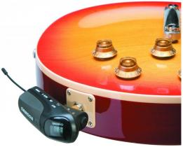

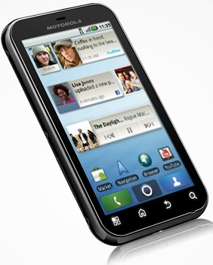
Product
FLORIAN
Hardware :
- 1 Electronic device
- 2 AAA rechargeable batteries (lasts 15 hours)
Software :
- 1 free Application to be downloaded from the Android market

Slide 7
Services
FLORIAN
Hardware :
- Sound transmission
    Plug and play
    Light and compact system
Software :
- Listening live to what is played on the guitar on you headphones or on the phone speaker
- Listening and Recording what is played
- Add some sound effects on what is played (i.e. reverb)

Slide 8
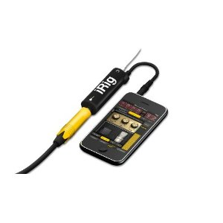
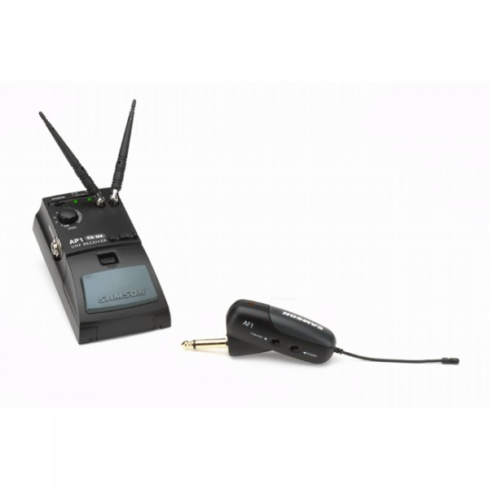
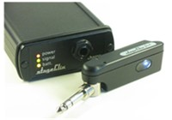
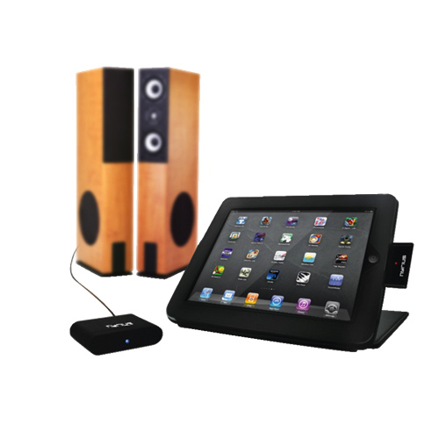
The Market
FLORIAN
  1. iRig (Cable)
2. Amson's Airline Guitar AF1
3. StageClix wireless guitar jack from Systec Designs(RF)
  4. NYRIUS (Bluetooth)
  → Several technical solutions, but no direct competition :
  JENDRIX IS A BREAKTHROUGH !

Slide 9
Commercial axes
FLORIAN
The commercial target :
→ Low budget students
→ mobile musiciens
Where to make the decision ?
  → On the internet
  → Through student events
  → In music instrument stores

Slide 10
Business Model
FLORIAN
FREE APPLICATION and DEVICE SOLD IN MUSIC INSTRUMENT STORES
BRICK and MORTAR + INTERNET
THE PRICE :

Slide 11
Business Model
FLORIAN
FREE APPLICATION and DEVICE SOLD IN MUSIC INSTRUMENT STORES
BRICK and MORTAR + INTERNET
THE PRICE :
79,95€

Slide 12
Business Model
FLORIAN
Manufacturing cost : 50€ HT
Selling price (all taxes incl.): 79€ (65€ Duty free)
Margin per U : 15€
Fixed operating costs : 10000€ / mois
Number of devices to sell per month for profit : 670

Slide 13
Premises
Pepinière
Labo
Matériel de protoypage
Instrumentation / mesures
Matériel informatique
ERIC

Slide 14
Product and services
Préséries
Développements à venir
Le freeware
ROMAIN

